Slide 1
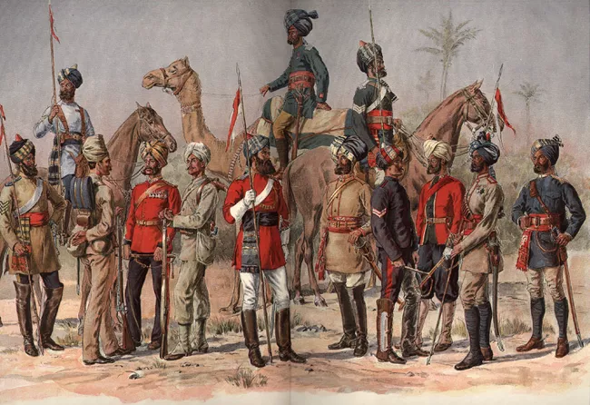
D.A.V PUBLIC SCHOOL
Impact of British Rule on India
Pakhowal Road,Ludhiana

Slide 2
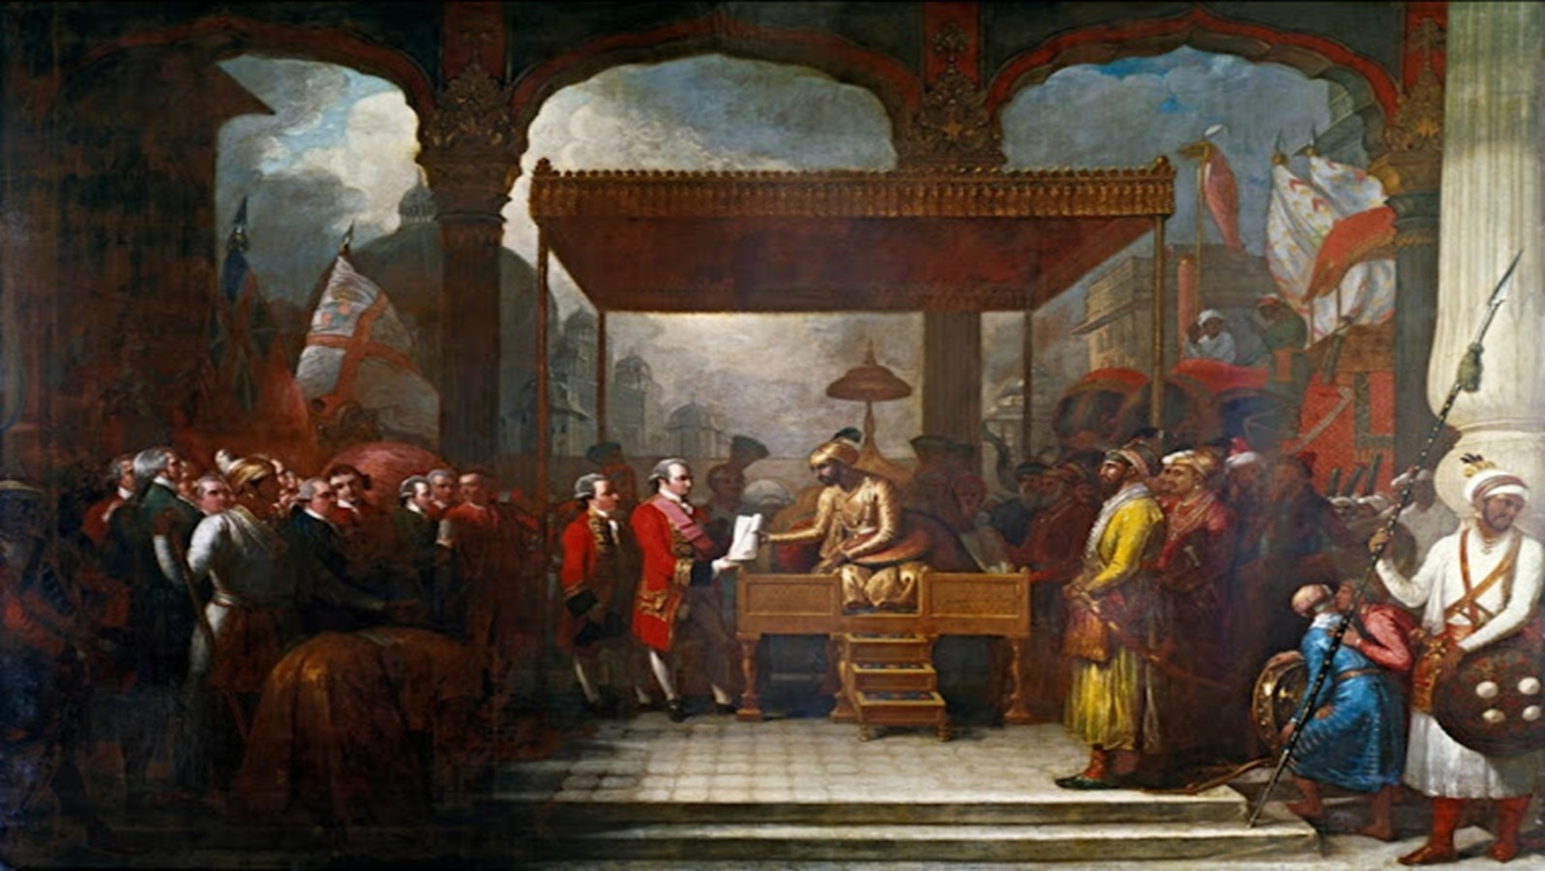

Positive Impact of British system of Education in India
• The English language united the people of different regions. People now rose above narrow regional prejudices and started thinking of India as their motherland.
• A surge of nationalism spread in all parts and all sections of India.
• It created awareness about the ideals of equality, liberty, fraternity and democracy.
•It created awareness about the need of social and religious reforms.
• Educated women like Sarojini Naidu joined the national movement
• In British system of education most of the people got full fledge education.
• Due to education the development level of that country increases.
• Due to education most of the people are employed in their(British)offices.

Slide 3
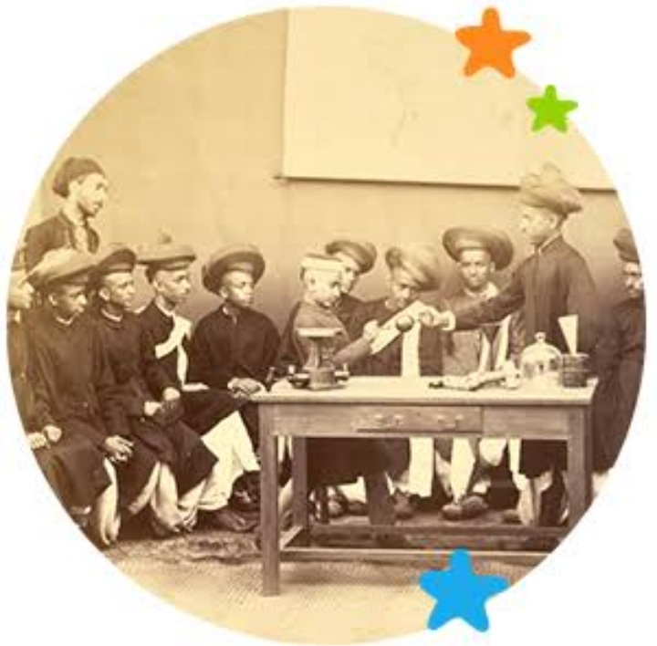
Negative Impact of British system of Education in India
• Education became the priority of those who could afford it and hence, only the rich Indians benefitted.
• British textbooks glorified the British administration and philosophy.
• It created a division between English educated Indians and the rest of Indians.
• Indigenous literature and thought were ignored.

Slide 4
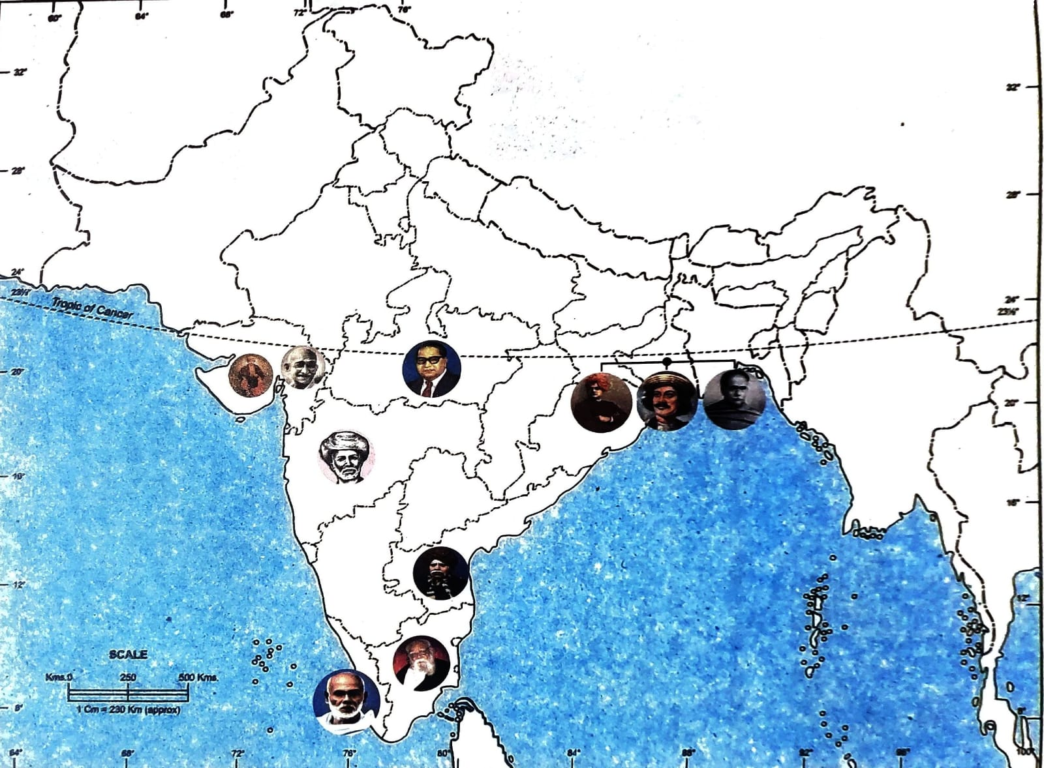
Social and Religious Reforms
During the nineteenth century, a social transformation began in India and kindled the spirit of nationalism. Many socio-religious reforms spread in India. In the princely states of Kochi and Travancore, the governmental positions were denied to lower castes and the non-Hindus.

Slide 5
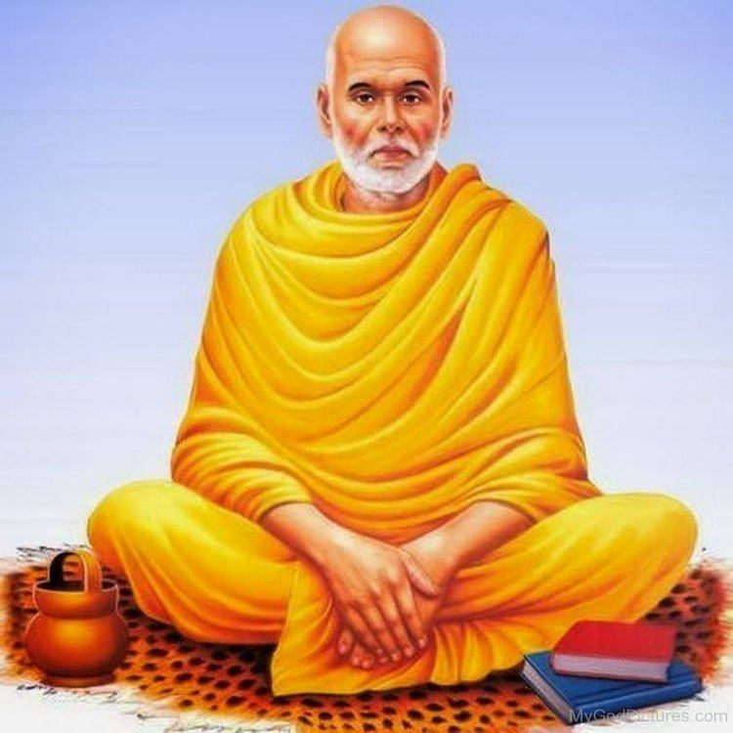
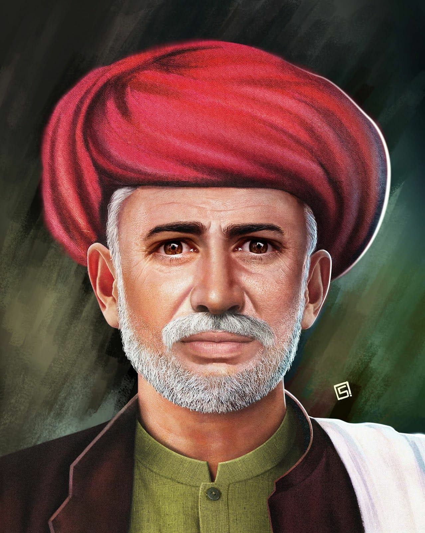
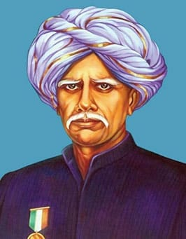
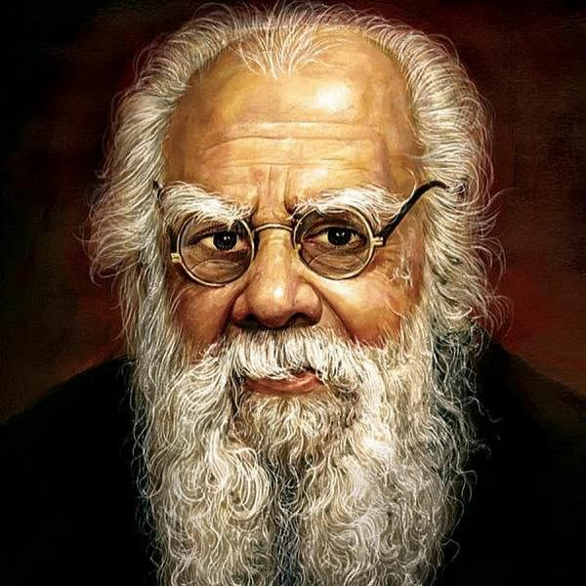
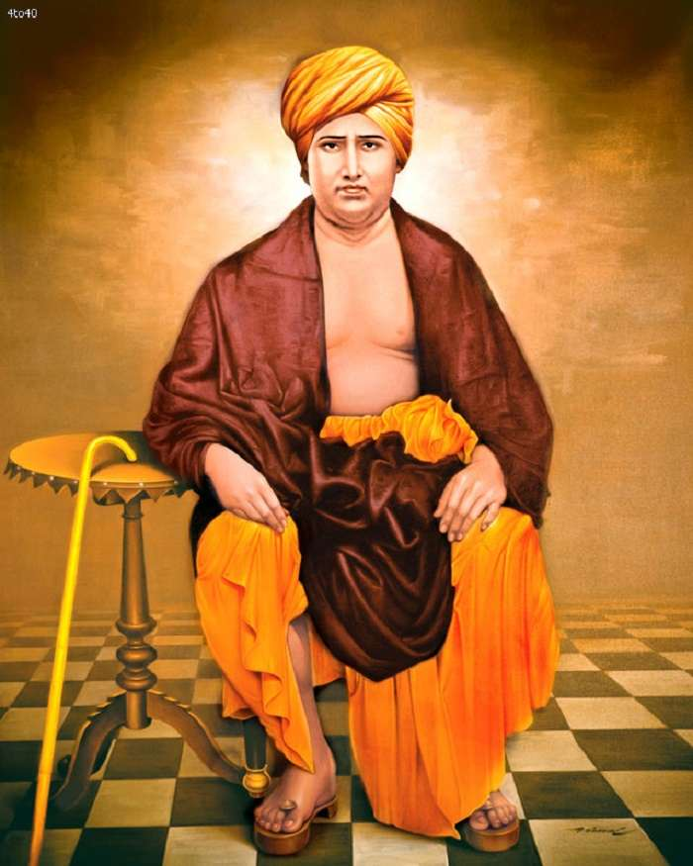
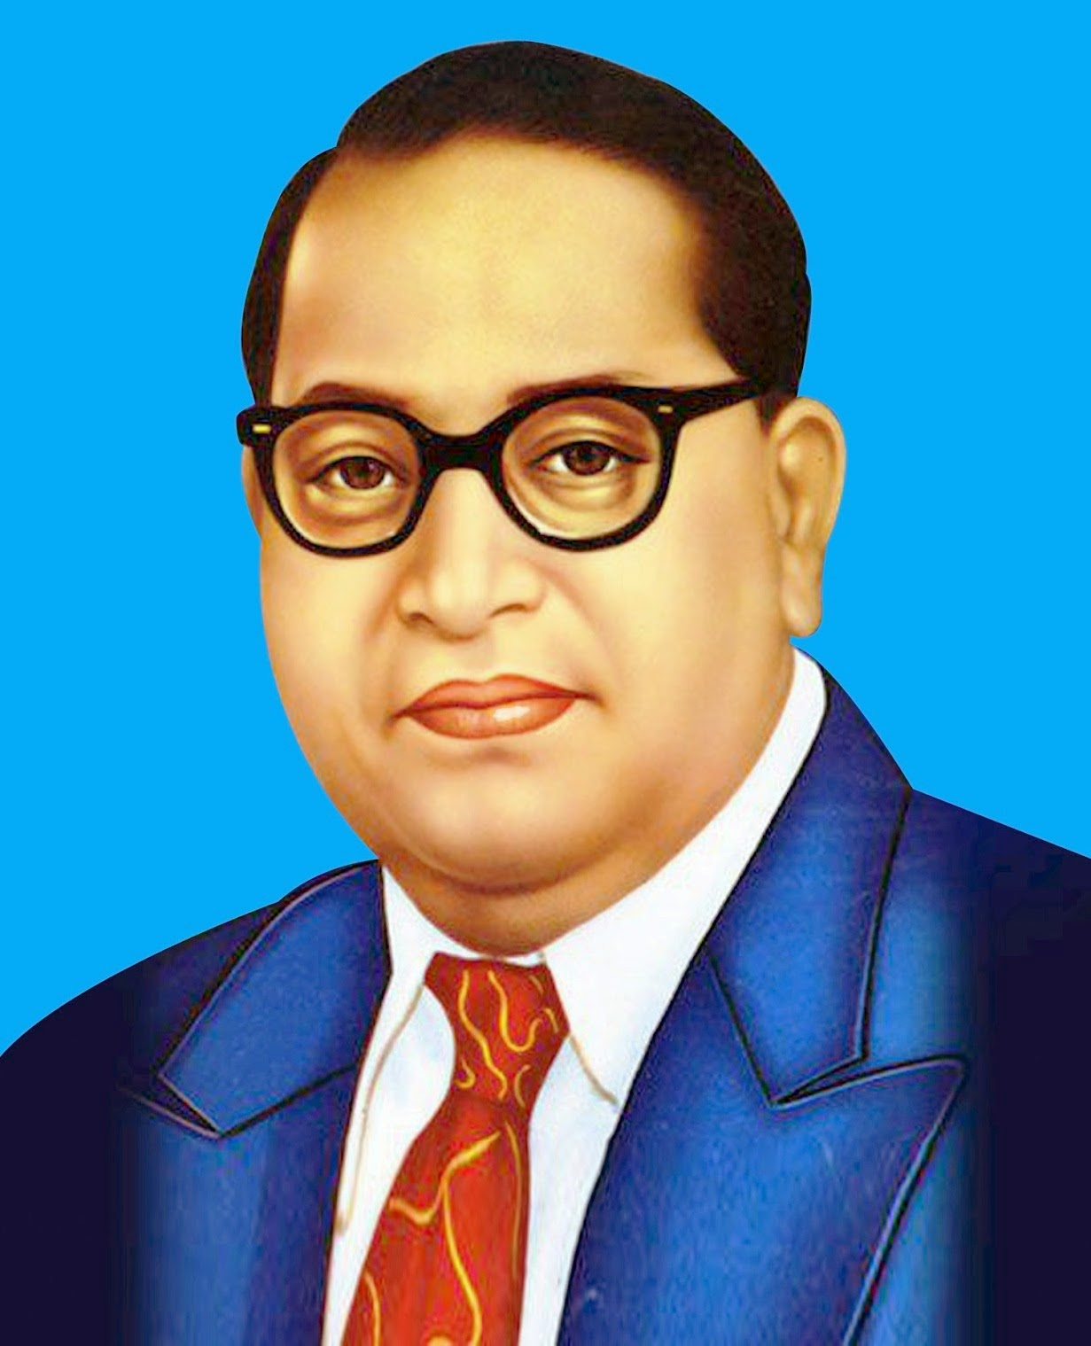
Social and Religious reformers
(1855-1928)
(1827-90)
(1848-1919)
Sree Narayana Guru
Jyotiba Phule
Veeresalingam Kandukuri
He campaigned against caste system , untouchability , Brahmin dominance and discrimination against lower castes.
He founded the Satya Sadhok Samaj ,an organization that worked for the upliftment of the low and oppressed classes.
He was a reformer and the first person to write a novel ,drama , books on natural science and history in Telugu.
(1879-1973)
(1824-83)
(1891-1956)
Periyar E.V. Ramasamy
Swami Dayanand Sarwati
Dr. B.R. Ambedkar
Periyar was a strong supporter of Dravidian culture and launched a Self-Respect Movement in 1925.He Propagated the the principles of nationalism, self-respect ,women’s right and eradication of caste system.
He wanted to build a free , strong and united India . These social and religious reformers prepared a background for nationalist movement of India. He was a great supporter of widow remarriage and women’s education.
He led millions of oppressed people to a life of self-respect and dignity. He founded the Bahiskrit Hitakarini Sabha and set-up hostels , schools to promote education and socio-economic upliftment of Dalits.

Slide 6
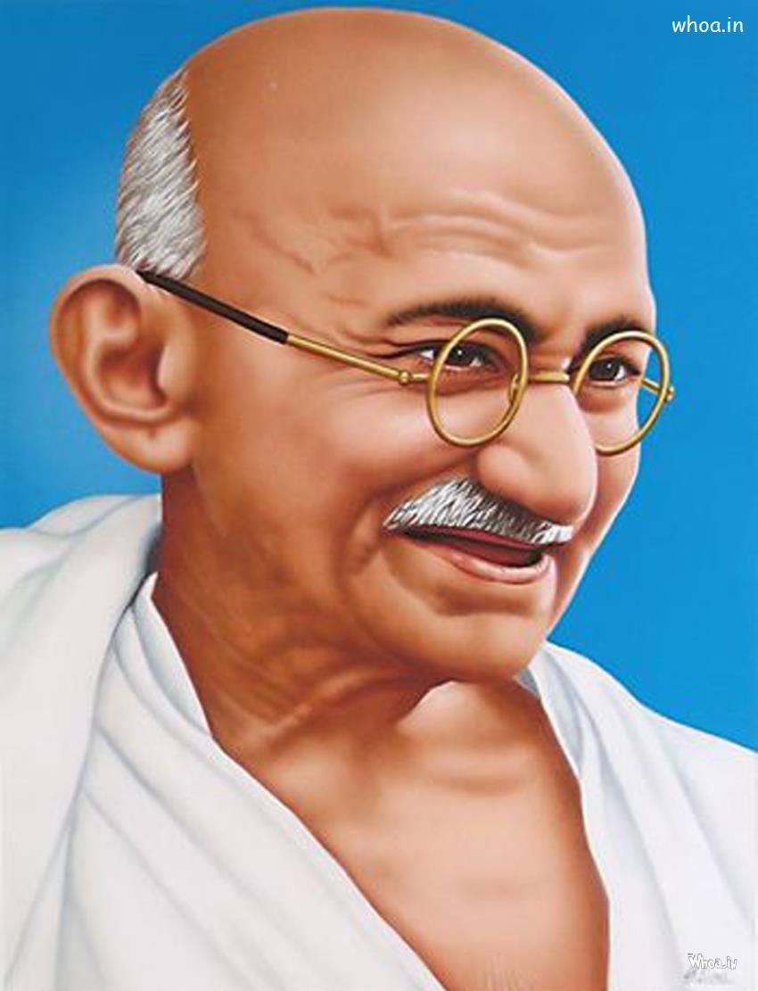
Mahatma Gandhi
(1869-1948)
Mahatma Gandhi, popularly known as Father of Nation, played a stellar role in India's freedom struggle. He initiated many activities like Satyagraha and Sarvodaya under non-violent resistance. He wanted to transform India into a community where every individual would serve others, especially, the poor and the meek.
Gandhiji was opposed to child marriage, untouchability and discrimination against women. He considered, so-called untouchables, as Harijans-people of God. He believed that the spinning wheel, khadi and revival of village industries were necessary for the villagers so that they do not have to migrate to cities in search of work.

Slide 7
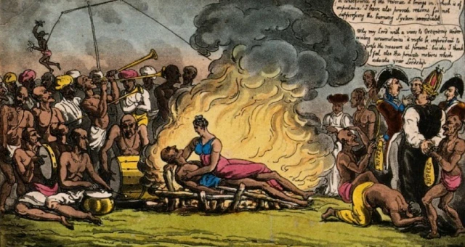
Social Impacts
English-Indians wanted to free the Indian society form evils , superstitions and rituals. Many reforms movements were started. Reformers like Raja Ram Mahon Roy and Swami Dayanand Sarasvati wanted to eradicate the evils from Indian society. They even compelled the British to pass some laws to introduce social reforms in India.
Sati was an inhuman practice where a widow was forced to burn herself on the funeral pyre of her husband.
Female Infanticide , killing of infant girls, was banned by law in 1870.
Child marriage of children as early as one or three years of age was banned by law in 1891 and again in 1929.
The Sharda Act of 1929, after amendment , fixed the age of marriage at 18 years for girls and 21 years for boys.
Widow Remarriage Act was passed by the British Government in 1856. It was with the persistent of Ishwar Vidya Sagar that widow remarriage was legalized.

Slide 8
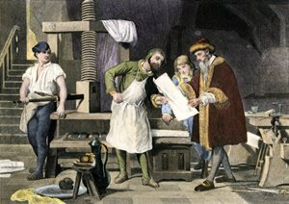
Impact of the Reforms Movement
The reforms brought a cultural awakening. India saw a rapid development in the field of art , literature , science and art.
The cast system had faced challenges since the times of Buddha and Mahavir , and even earlier than that. But it was during movements that the opposition to the opposition to the caste system spread throughout the India and among all the sections of the society.
The Printing Press played a pivotal role in mobilizing public opinion. It enabled the reformers to spread awareness through their writings.

Slide 9

THANK YOU !
Kamakshi,Kanav,Kavish,Khushi,Lavanya,Mankirat,Mannat

